Slide 1
Analysis of Amazon Prime Dataset
Home
About me
What I do
My experience
My work
Understanding Trends and Consumer Behavior on Amazon Prime

Slide 2
What is Power BI
Home
About me
What I do
My experience
My work
Power BI is the Software use for collecting, storing, analyzing, and transforming data into actionable insights to support better decision-making within an organization.
Key Components of BI:
Data Collection: Gathering data from various sources such as databases, spreadsheets, and external APIs.
Data Warehousing: Storing and managing the collected data in a centralized system.
Data Analysis: Applying analytical tools and techniques to uncover patterns, correlations, and trends.
Data Visualization: Presenting the insights in graphical forms like charts, graphs, and dashboards for easy understanding .
Reporting: Creating regular reports to monitor and measure performance against business objectives.

Slide 3
Why Analyze Amazon Prime Data?
Consumer Behavior Insights
Service Improvement
Trend Prediction
Competitive Advantage
01
02
Identifying potential areas of improvement to enhance user experience.
Understanding what content are most popular with customers.
03
04
Analyzing trends to predict future customer needs.
Leveraging insights for a strategic advantage in a competitive market.

Slide 4
Report
Home
About me
What I do
My experience
My work
01

Slide 5
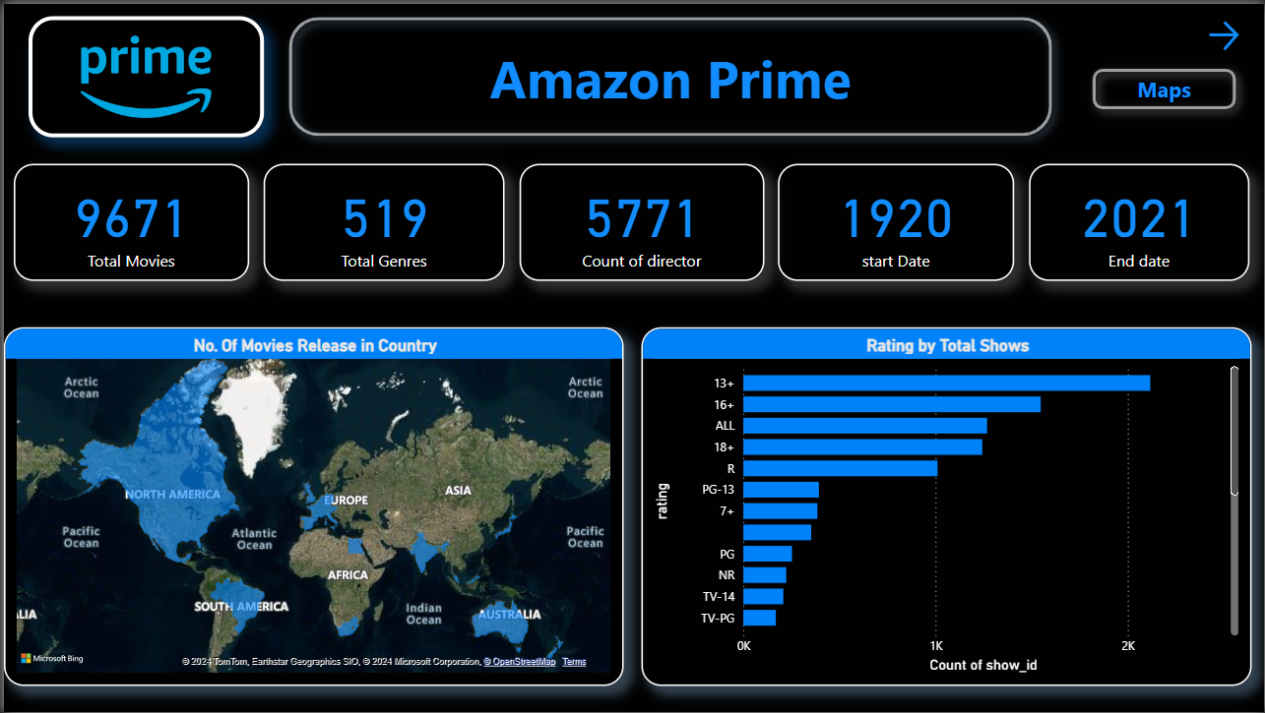
Home
About me
What I do
My experience
My work

Slide 6
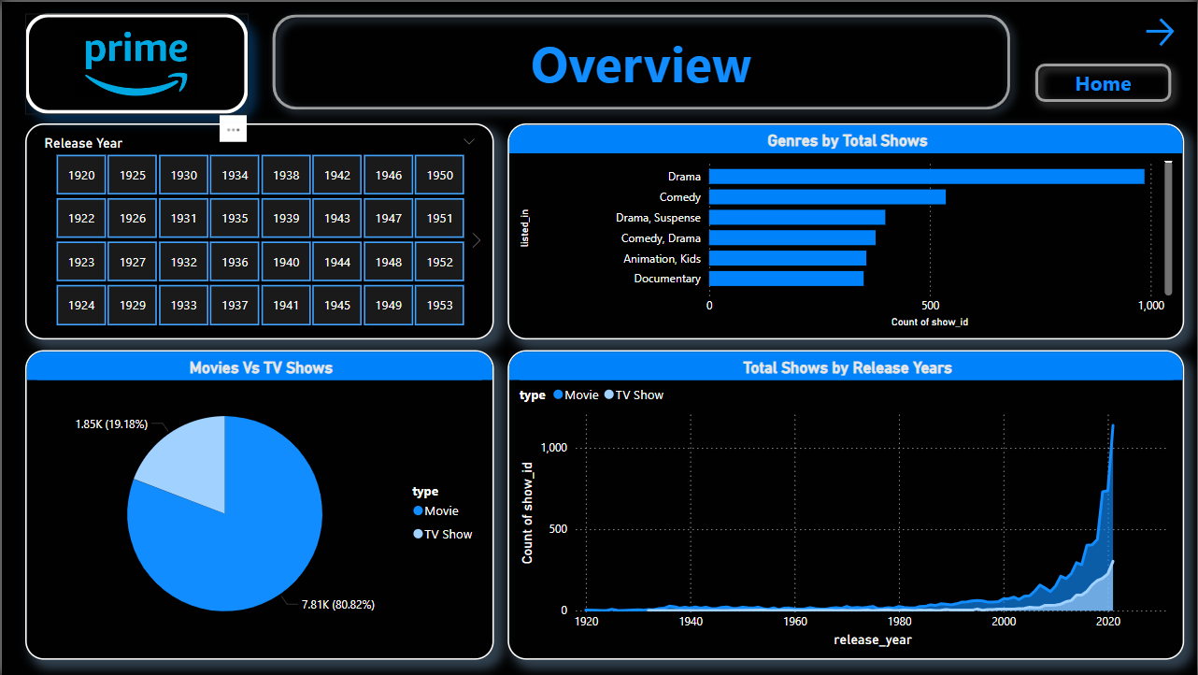
Home
About me
What I do
My experience
My work

Slide 7
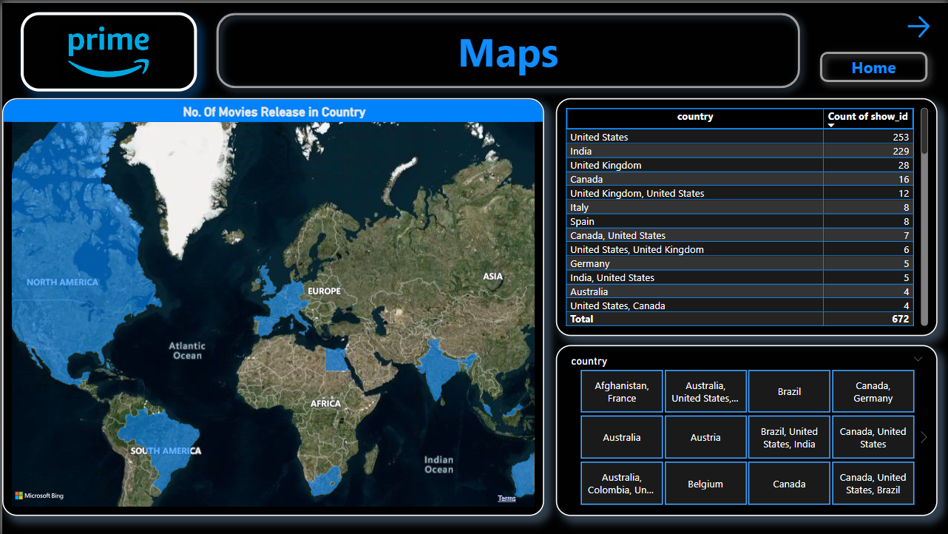
Home
About me
What I do
My experience
My work

Slide 8

Problem Statement
Objective
Home
About me
What I do
My experience
My work
To uncover key insights from Amazon Prime’s content data and user engagement data.
Challenges:
Complex data with a variety of content and user interactions.
Extracting actionable insights for strategic planning.
Making sense of large datasets to improve user experience and retention.

Slide 9
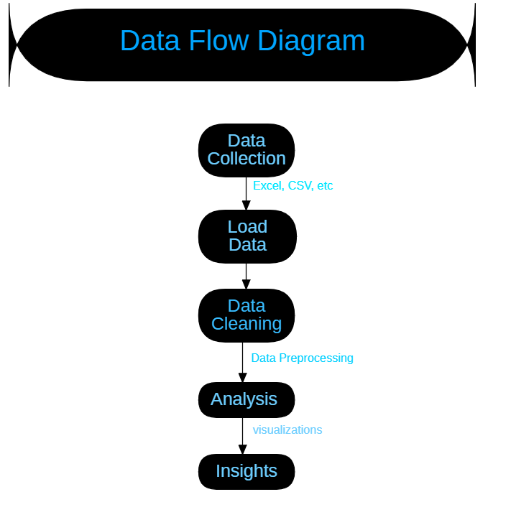
Home
About me
What I do
My experience
My work

Slide 10
Visualizations
Home
About me
What I do
My experience
My work
02

Slide 11
9,671
Home
About me
What I do
My experience
My work
Total Movies & TV Shows

Slide 12
Maps
Home
About me
What I do
My experience
My work
Country
01
Country Name eg:- India
01
03
Number of Shows
02
Movies & TV Shows
Highest Release Shows
02
03
Highest Movies & TV Shows Release in Country

Slide 13
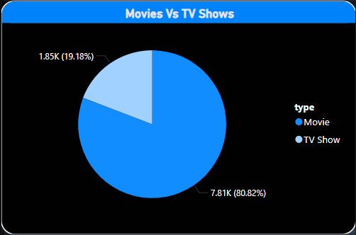
Pie Chart
Home
About me
What I do
My experience
My work
A pie chart showing the distribution of movies and TV shows on Amazon Prime provides a quick visual comparison of the two categories within the platform's content data. Typically, this chart would show the proportion of movies versus TV shows available for streaming on Amazon Prime, allowing viewers to understand the balance between the two types of content.

Slide 14
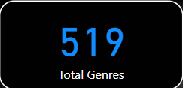
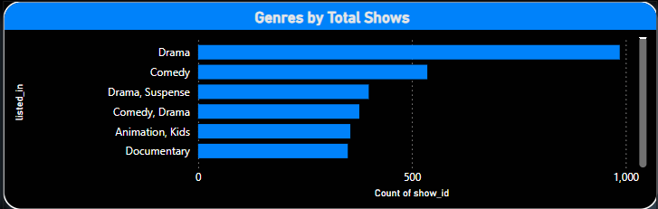
Bar Chart
Home
About me
What I do
My experience
My work
The bar chart can show which genres dominate Amazon Prime’s library, with taller bars representing more content. For example, if Drama and Comedy genres have the highest bars, it indicates these are focus areas for Amazon Prime. Highlighting the most popular genres could give insights into what content the platform expects will attract the most viewers.

Slide 15
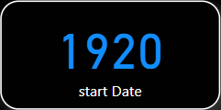
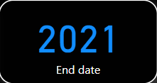
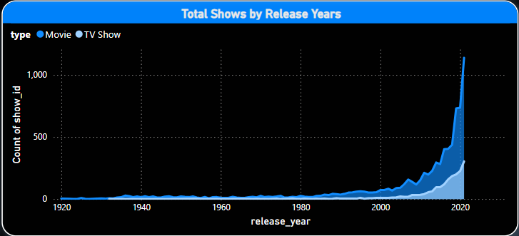
Area Chart
Home
About me
What I do
My experience
My work
Increase in Content Over Time
Modern Content Focus
Movie Dominance
Gradual Increase Until 2000
Effect of Streaming Boom
Limited Older Content

Slide 16
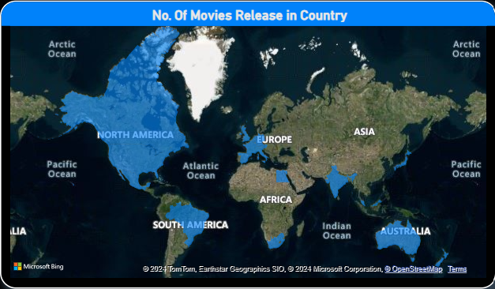
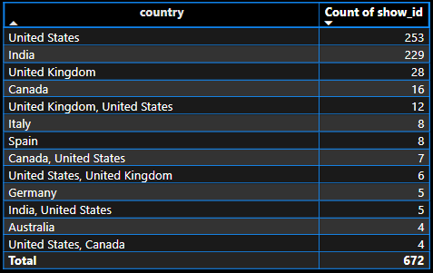
Table Chart
Home
About me
What I do
My experience
My work
This table shows the distribution of Amazon Prime content by country, listing the number of shows available from each.
Top Content Producers : The United States (253 shows) and India (229 shows) dominate Amazon Prime's content library, making up a large portion of the platform’s offerings. This reflects Amazon Prime’s focus on these major markets .
Other Countries : The United Kingdom (28 shows) and Canada (16 shows) follow, contributing a smaller but significant number of shows. These countries are key secondary markets for Amazon Prime.
Total Content Count : In total, the library represented in this table has 672 shows, showcasing Amazon Prime’s extensive catalog across multiple regions.

Slide 17

Goal
Home
About me
What I do
My experience
My work
To create a comprehensive overview of Amazon Prime’s Dataset and understand trends in content consumption.
To leverage data for improving recommendations, content curation, and user satisfaction.
To provide data-driven recommendations for growth and improved customer engagement.

Slide 18
Conclusion
Home
About me
What I do
My experience
My work
The Power BI analysis of the Amazon Prime dataset provides a comprehensive understanding of user behavior, content preferences, and subscription trends. The findings reveal high engagement levels with specific genres and content types, indicating clear user preferences and viewing habits. Additionally, the analysis highlights noticeable trends in content consumption, with certain genres and release years showing higher popularity. Subscription trends are also evident, showcasing significant growth and retention, which offers insights into user loyalty and satisfaction. Furthermore, the correlation between IMDb ratings, user reviews, and content quality emphasizes the importance of high-quality content for viewer retention. Geographical insights from the analysis uncover regional preferences and trends, which can help tailor content strategies for different markets. Overall, this analysis demonstrates the power of data analytics in understanding and optimizing Amazon Prime’s content strategy and user experience.

Slide 19

THANKS!
Home
About me
What I do
My experience
My work

